Slide 1
ATAL BIHARI VAJPAYEE- INDIAN INSTITUTE OF INFORMATION TECHNOLOGY MANAGEMENT ,GWALIOR
ECG-Based Heart Arrhythmia Diagnosis Through
Attentional Convolutional Neural Networks

Slide 2
2021IMT-045
2021IMT-088
2021IMT-089
2021IMT-094
Ipsa Badoniya
Shail
Shalini Kumari
Shruti Murthy
Prof. Mahua Bhattacharya

Slide 3
CONTENTS
Introduction
Background of the Problem
Proposed Approach
Related Works
Methodology
Experiment Details
Results
Conclusion

Slide 4
INTRODUCTION
Electrocardiography (ECG) is a widely used medical tool for recording the heart beat. It helps in diagnosing heart conditions like arrhythmia, where the heart beats irregularly.
Arrhythmias can be life-threatening if not detected early, leading to symptoms like chest pain, dizziness, and shortness of breath. Accurate and fast diagnosis is critical for proper treatment.
Traditional approaches require manual data preparation and feature extraction. This process is time-consuming.
To address this, a new model, Attention-Based Convolutional Neural Networks (ABCNN), is introduced, which works directly with raw ECG data, improving the accuracy and efficiency of arrhythmia detection​

Slide 5
BACKGROUND OF THE PROBLEM
Detecting arrhythmias is primarily done using Electrocardiograms (ECG), which measures the activity of the heartbeat. However, traditional methods of diagnosing arrhythmia face several challenges:
Manual Feature Extraction: Requires extensive domain knowledge to manually identify important parts of the ECG, making the process slow and prone to errors.
Complex ECG Data: Variability in ECG signals between patients makes arrhythmia detection difficult.
Real-Time Processing: Traditional methods struggle to meet the demand for real-time analysis.
Data Imbalance: Some arrhythmias are rare, making it harder to train machine learning models effectively.

Slide 6
PROPOSED APPROACH
The paper presents a new model called Attention-Based Convolutional Neural Network (ABCNN) to detect irregular heartbeats (arrhythmias) from ECG data.
ABCNN automatically focuses on the most important parts of the ECG signal, which helps in detecting arrhythmias more accurately.
The model can work directly with the raw ECG data, so there’s no need to manually pick out features from the signal, saving time and effort.
It uses a method called “multi-head attention” to look at different parts of the ECG signal, which helps the model understand the data better.
The model is able to find and identify different types of irregular heartbeats.

Slide 7
RELATED WORKS
Traditional Machine Learning Approaches:
Models like SVM, Random Forest required manual feature extraction from ECG signals.
Labor-intensive and dependent on domain knowledge.
Deep Learning Approaches:
CNNs improved ECG analysis by automating feature extraction.
LSTMs were used for temporal dependencies but were computationally expensive.

Slide 8
METHODOLOGY
ABCNN combines Convolutional Neural Networks (CNN) with attention mechanisms to enhance heart arrhythmia detection from raw ECG signals.
• Key Components:
- CNN for feature extraction.
- Attention mechanism to highlight important ECG segments (e.g., QRS complex).
- Fully connected layers for final classification.
Key Advantage: No manual feature extraction is required.

Slide 9
ARCHITECTURE
The ABCNN architecture is structured as follows:
Input Layer: The raw ECG signal is provided as a [2, 240] matrix, where there are 2 channels and 240 time points.
Attention Layer: Computes attention weights for each time point, highlighting the most important parts (like the QRS complex), enhancing arrhythmia detection by focusing on key signal segments.
First Convolutional and Pooling Layers: The first convolutional layer extracts local features, while the first pooling layer reduces dimensionality via max pooling, making the model more efficient.
Second Convolutional and Pooling Layers: A second convolution extracts deeper features, and the second pooling layer further reduces feature map size.
Fully Connected Layers: Flattened features are passed through two fully connected layers for complex pattern learning and final prediction.

Slide 10
ARCHITECTURE
Multi-Head Attention Mechanism in ABCNN
Why Multi-head Attention is Important:
- ECG signals contain segments with varying importance (e.g., QRS complex).
- Traditional models treat all segments equally, missing critical features.
Multi-Head Attention:
- Multiple attention heads capture different patterns from various signal sections.
- Each head focuses on specific parts of the signal (e.g., the QRS complex).
- Outputs from all heads are combined to enhance classification

Slide 11
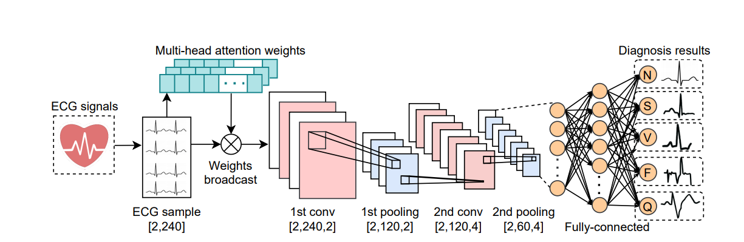
ARCHITECTURE
Workflow of ABCNN

Slide 12
EXPERIMENTAL DETAILS
1. Dataset:
MIT-BIH Heart Arrhythmia dataset
4,000 recordings from 47 patients
Each heartbeat represented by 240 sampling slices
Split into 80% training and 20% testing sets
2.Data Preprocessing:
Standard z-score normalization applied to prevent scale variations
3.Model Architecture:
ABCNN model
Multi-head attention layer to focus on important segments (e.g., QRS complex)
Two convolutional layers, two pooling layers, two fully connected layers
Five-node classifier for arrhythmia classification

Slide 13
EXPERIMENTAL DETAILS
4. Training Procedure:
Evaluated different activation functions over 100 and 500 epochs.
ABCNN outperformed traditional machine learning models like SVM and RF, achieving an AUC of 98.96%

Slide 14
RESULTS
High Accuracy: ABCNN achieved an AUC of 98.96%, outperforming traditional models.
Class-wise Performance: Strong performance for common arrhythmias, but lower accuracy for rare types like fusion beats.
Effective Attention: The attention layer improved detection by focusing on crucial ECG segments.
Real-time Feasibility: Inference time under 0.1 seconds makes it practical for real-world use.

Slide 15
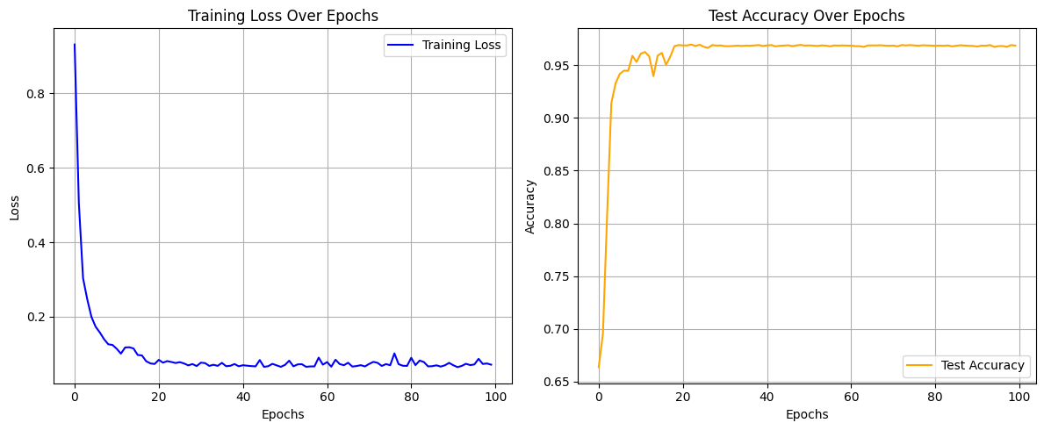
RESULTS

Slide 16
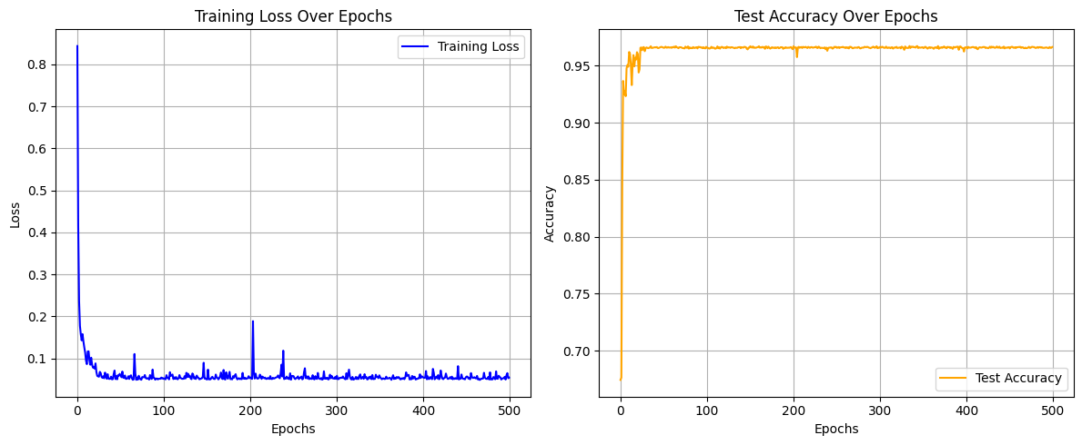
RESULTS

Slide 17
CONCLUSION
ABCNN effectively diagnoses heart arrhythmias, outperforming traditional models.
Attention mechanism improves accuracy by focusing on critical ECG segments.
High AUC score (98.96%) demonstrates superior performance.
Real-time capability makes ABCNN suitable for clinical deployment.

Slide 18
THANK YOU

